Slide 1

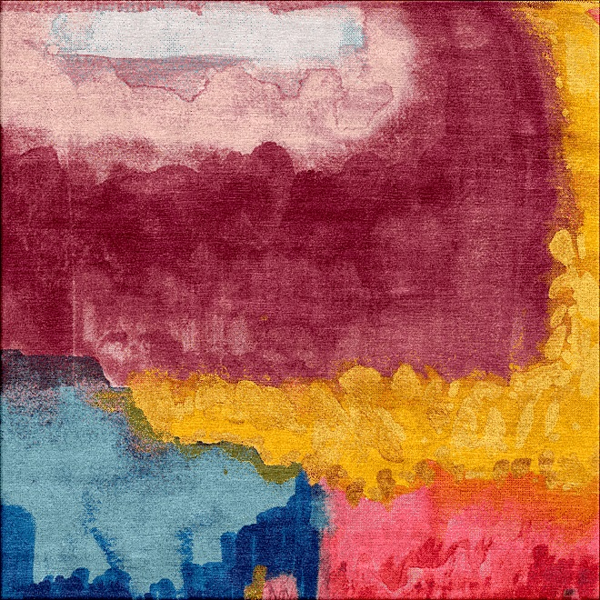
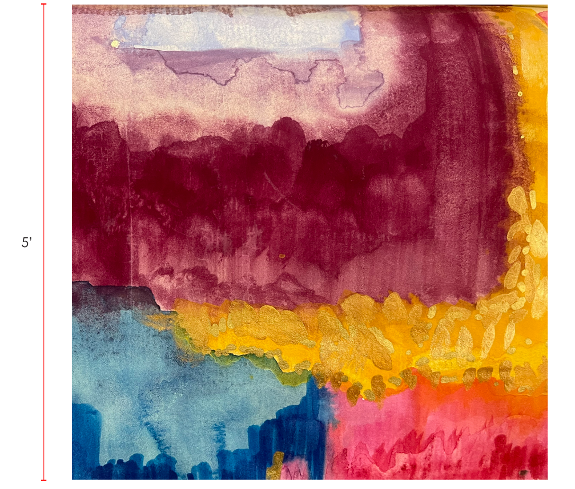
Date : 20/05/026
Construction : Hand Knotted – 11/11
Customized Project
PD-12926-ND
Sands Solution
JRC +ARS reference
^{#1. Silk Wool Mix Ply}
^{#2. Silk Wool Mix Ply}
^{#3. Silk Wool Mix Ply}
^{#4. Silk Wool Mix Ply}
5 Feet
^{#5. Silk Wool Mix Ply}
^{#6. Silk Wool Mix Ply}
^{#7. Silk Wool Mix Ply}
^{#8. Silk Wool Mix Ply}
^{#9. Silk Wool Mix Ply}
^{#10. Silk Wool Mix Ply}
^{#11. Silk Wool Mix Ply}
^{#12. Silk Wool Mix Ply}
^{#13. Silk Wool Mix Ply}
^{#14. Silk Wool Mix Ply}
^{#15. Silk Wool Mix Ply}
5’Feet
^{#16. Silk Wool Mix Ply}
^{SIZE}
^{CUSTOMER METRICS}
^{SHAPE}
^{RUG QUALITY}
^{FIBRE CONTENT}
^{DYEING TECHNIQUE}
^{FINISH EDGE}
^{FINISH PILE HEIGHT}
^{FINISH PILE TYPE}
^{FINISH BACKING}
^{FINISH WASH}
^{: 5’ Feet X 5 Feet}
^{: CMS}
^{: RCT}
^{: Hand Knotted 11/11}
^{: Silk & NZ Wool}
^{: Standard}
^{: 4 side binding}
^{: Standard}
^{: Cut Pile}
^{: No Backing}
^{: Standard}
^{#17. Silk Wool Mix Ply}
^{#18. Silk Wool Mix Ply}
^{#19. Silk Wool Mix Ply}
^{#20. Silk Wool Mix Ply}
^{#21. Silk Wool Mix Ply}
^{#22. Silk Wool Mix Ply}
^{#23. Silk Wool Mix Ply}
^{#24. Silk Wool Mix Ply}
^{#25. Silk Wool Mix Ply}
Pile Height – 7-8 MM
Rug Image / Design Intent
Signature : ____________________
Date of Approval :_____________

Slide 2
Customized Project
INFO SECTION
A custom rug is by nature a unique product.
Slight variations in color and size are normal.
Please note: all custom rugs can have a variance of +/- 3 inches.
No changes once order is placed.
No cancellations once items are in production.
You may cancel your custom rug order within 5 business days from the date of the order without penalty. If you wish to cancel standard customs after 5 business days, your deposit will be forfeited.
No returns/refunds of Custom Rug.
Size limitations vary between collections.
Production times are an estimate. All efforts will be made to produce in the time quoted.
Final delivery of your custom rug will vary based on size, construction and shipping method.
Signature : ____________________
Date of Approval :_____________

